Slide 1
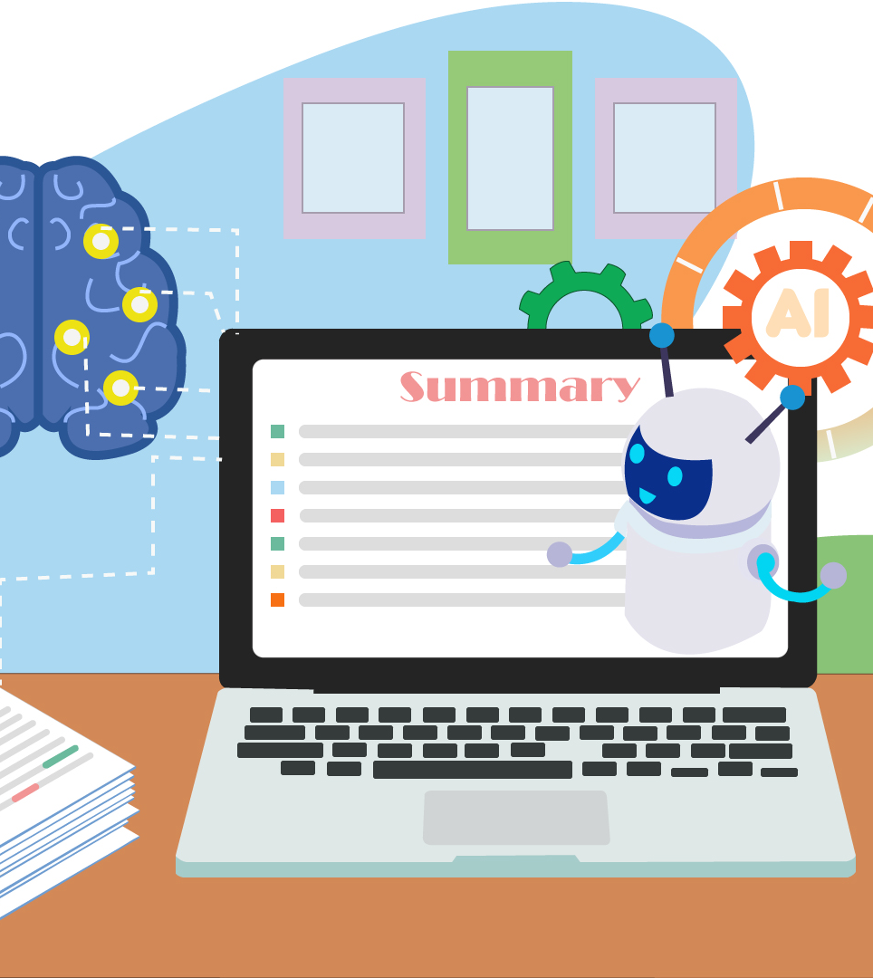
End-to-End Text Summarization and Analysis System
Summarization, Sentiment Analysis, Keyword Extraction, Topic Modeling
IT3041 - IRWA Group Project.
Data seekers.

Slide 2
Agenda
Introduction
Understanding of Core Concepts
System Architecture
Implementation
Data Handling
Evaluation Metrics
Innovation and Novelty
Responsible AI
Commercial Value
Front-End Development with Streamlit
Scalability and Future Improvements
Conclusion

Slide 3
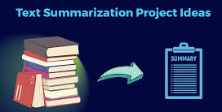
Introduction
Welcome to our presentation on the Text Summarization and Analysis System. Our tool efficiently processes large text by providing summaries, sentiment analysis, keyword extraction, and topic modeling. Using advanced NLP techniques like the Hugging Face T5 model and VADER, we aim to enhance text analysis. Let’s explore the core features and architecture of our system.

Slide 4
Understanding of Core Concepts
Summarization:
Utilizes Hugging Face's T5-large model.
Handles large text by breaking it into chunks.
Offers summaries of varying lengths: short, medium, long.
Sentiment Analysis:
Implements VADER Sentiment Analyzer.
Classifies text as positive, neutral, or negative based on compound sentiment scores.
Keyword Extraction:
Employs the YAKE algorithm for unsupervised extraction.
Considers statistical and linguistic features for effective keyword identification.
Topic Modeling:
Utilizes Latent Dirichlet Allocation (LDA) from Gensim.
Identifies topics within text based on word distributions.

Slide 5
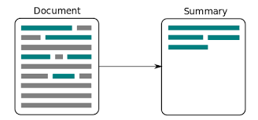
System Architecture
Modular Design:
Each functionality (summarization, sentiment analysis, keyword extraction, topic modeling) is a separate module in the code, making the system more maintainable.
Text Processing Workflow:
The user inputs text into the app.
Text is preprocessed (tokenization and lemmatization).
Summarization and analysis tasks (sentiment analysis, keyword extraction, topic modeling) are executed sequentially.
Handling Large Text:
Large texts are split into chunks for efficient processing by the T5 summarization model.

Slide 6
Implementation
Modularity:
Functions like summarize_large_text and extract_keywords_from_large_text are well-structured for easy maintenance.
Reusability:
Helper functions (e.g., preprocess_text) are reused across multiple tasks, enhancing efficiency.
Error Handling:
Implement checks in app.py to validate text length and format before processing.

Slide 7
Data Handling
Preprocessing:
Text is tokenized and lemmatized using SpaCy before keyword extraction and topic modeling.
This step ensures that the text is clean and manageable for further processing.
Handling Large Text for Summarization:
Large texts are split into smaller segments (tokenization) to fit within T5’s input size constraints.
These chunks are summarized individually and combined to provide the final output.

Slide 8
Evaluation Metrics
Sentiment Analysis Testing:
Accuracy can be evaluated using pre-labeled datasets with known sentiments.
Keyword/Topic Evaluation:
Evaluation can involve expert-generated keywords or coherence scores for topic modeling to measure topic coherence and relevance.

Slide 9
Innovation and Novelty
Multi-Faceted Tool:
Combines summarization, sentiment analysis, keyword extraction, and topic modeling in a single system.
Provides comprehensive text analysis, which is unique in terms of functionality.
Dynamic Summarization:
The user can select different summary lengths (short, medium, long), giving them control over the level of detail.
Real-World Applications:
Useful in summarizing research papers, business documents, product reviews, and extracting keywords for SEO.
The app can also analyze sentiments and discover topics in lengthy texts.

Slide 10
Responsible AI
Bias in NLP Models:
Pre-trained models like T5 and VADER may carry biases based on their training data.
The system may inadvertently generate biased summaries or sentiment analysis outputs, reflecting these biases.
Data Privacy:
If deployed in production, sensitive user data must be handled securely, with measures in place to protect user privacy.
No user data should be stored without proper consent.

Slide 11
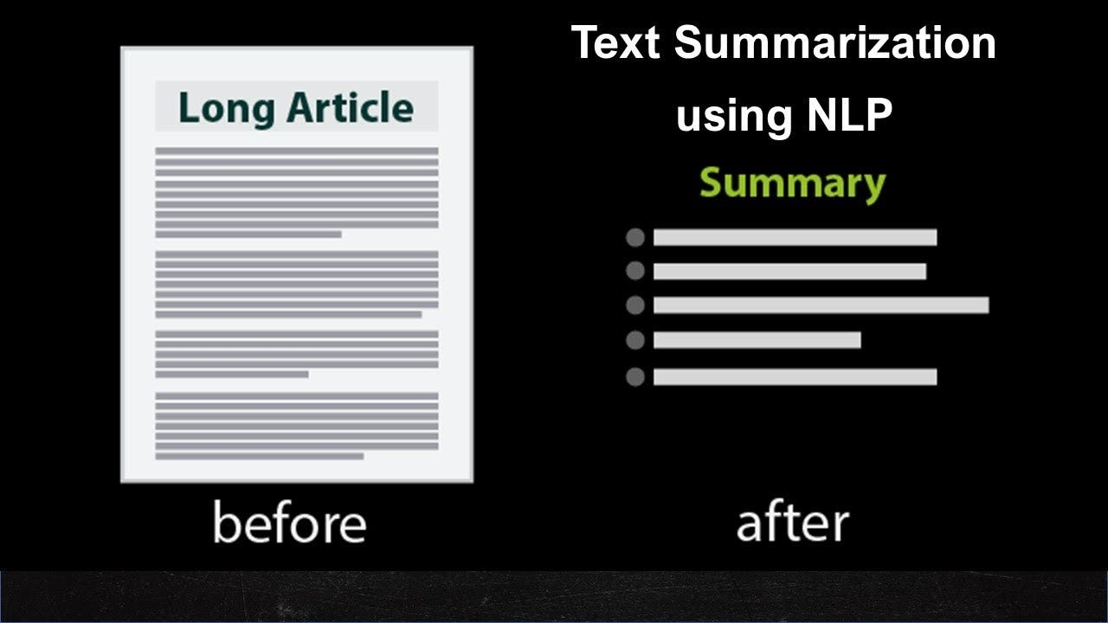
Commercial Value
Real-World Use Cases:
The system can summarize long documents, news articles, and research papers efficiently.
It can perform sentiment analysis for reviews (e.g., product reviews), helping businesses understand
Keyword extraction can assist with SEO optimization by identifying relevant keywords from a text.

Slide 12
Front-End Development with Streamlit
User Interface:
Intuitive layout for users to input text for summarization and analysis.
Dynamic selection options for summary length (short, medium, long).
Display sections for results, including sentiment analysis, keyword extraction, and topic modeling

Slide 13
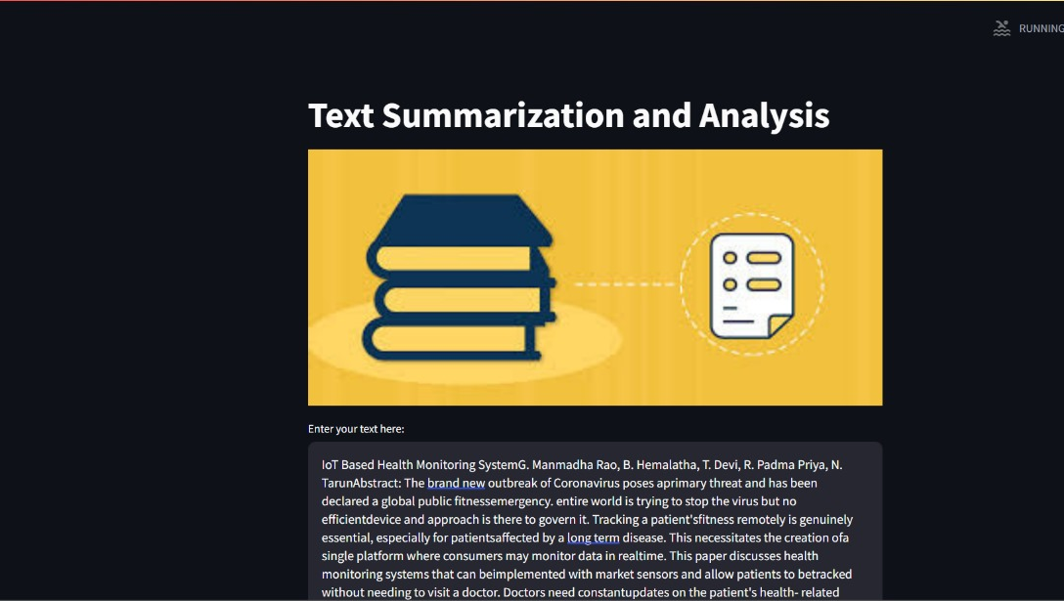

Slide 14
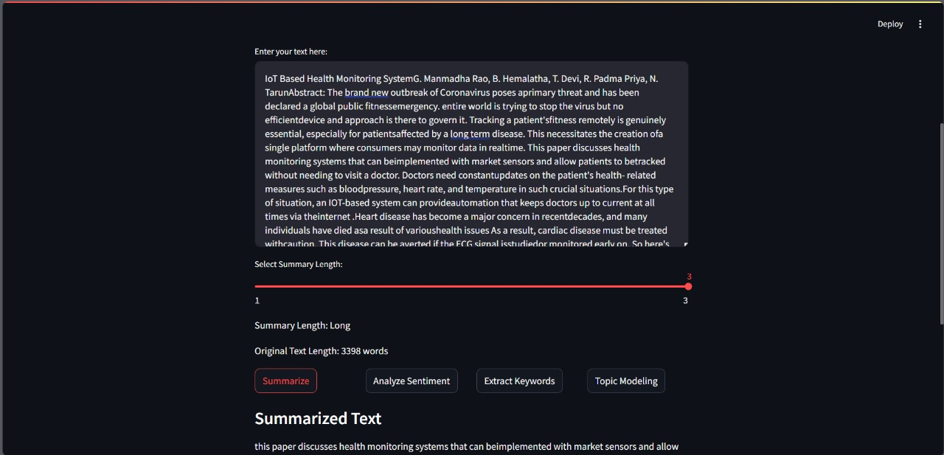
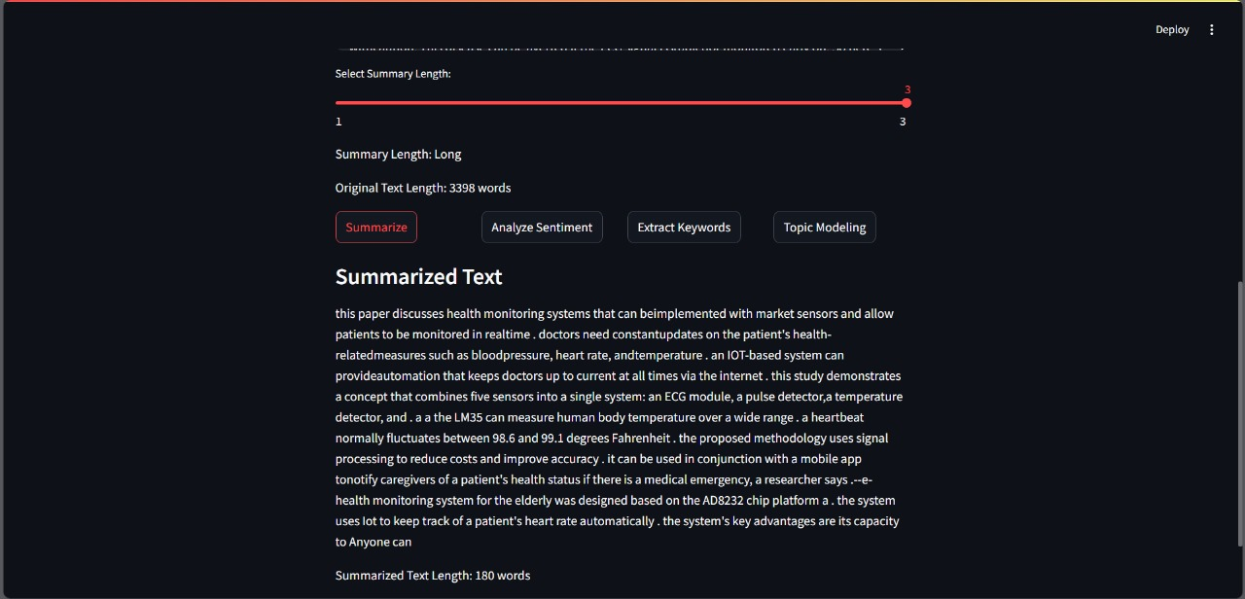

Slide 15
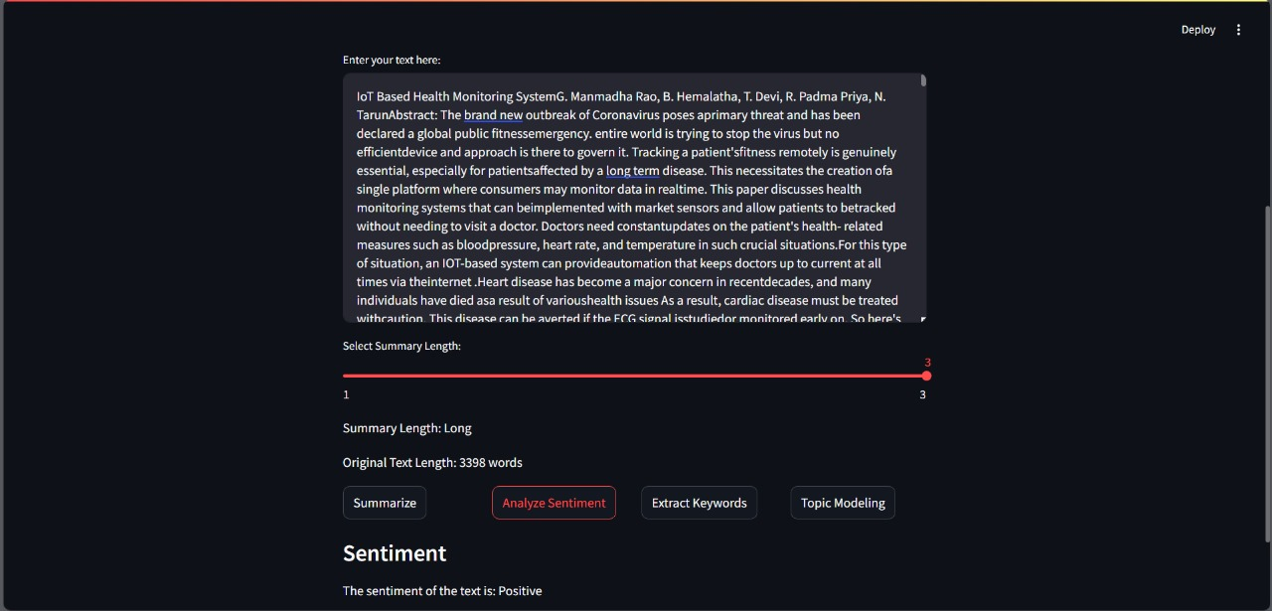
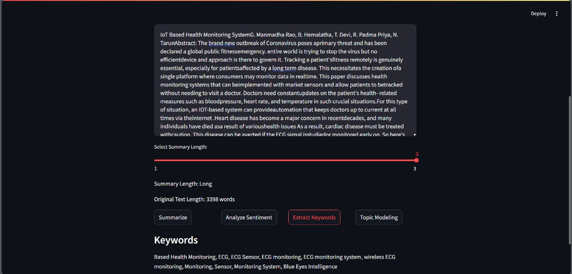

Slide 16
Scalability and Future Improvements
Scaling the App: Strategies for handling larger texts and batch processing using cloud services (AWS, GCP).
Adding More Features: Future plans for multilingual summarization, text translation, and additional evaluation metrics.

Slide 17
Conclusion
Robust Text Analysis: The application provides comprehensive tools for text summarization, sentiment analysis, keyword extraction, and topic modeling, enhancing user understanding of textual data.
Modular Design: Its modular architecture allows for easy maintenance and future scalability, supporting the integration of new NLP features.
User-Friendly Interface: Built with Streamlit, the front end ensures an intuitive user experience, making complex analyses accessible to all users.
Promising Evaluation: Initial tests indicate effective performance in generating summaries and sentiment insights, with opportunities for further metric refinement.
Future Enhancements: Plans for future improvements include multi-language support and optimization for larger datasets.
Ethical Considerations: The project highlights the importance of responsible AI practices, focusing on bias mitigation and data privacy.
Overall Impact: This project showcases the power of NLP technologies and their potential applications in various domains.

Slide 18
Individual Contribution
IT22237590 :UI design and Keyword Extraction
IT22267122 : Chunks and Text Summarization
IT22221032 :Topic Modeling
IT22295538 : Sentiment Analysis and Redundancy Checking

Slide 19
Thank you

